Slide 1
Activity Recognition Using Smartphones
Classification of Human Activity

Slide 2

Agenda
Project Background
Experiment Data
Exploratory Data Analysis
Modeling Techniques
Results & Conclusions

Slide 3
Project Background
Human Activity Recognition (HAR) is the classification of sequences of sensor data into human activities
Time series, multi-class classification problem ideally performed on smartphone or in cloud
Experiment consists of 12 activities performed by 30 volunteers
Experiment data is from a smartphone accelerometer and gyroscope worn on waist (Samsung Galaxy S2)
Video was recorded for each subject and the movement data was manually labeled
SVM classification accuracy 89% in 2012

Slide 4
Experiment Data
Data Capture & Pre-Processing
Raw Data
People perform activities
Smartphone on waist
Filter Data
High-Pass filter for noise
Feature Engineering
Compute time and frequency features in commonly used in HAR
Split accelerometer into body and gravity motion
Labels created manually from video
Features scaled between -1 and 1
Modeled Dataset
Dataset consists of 10,929 observations with 561 features
Dataset was split 70%/30% into training and testing datasets
No missing values

Slide 5

Experiment Activities
Activities Performed (video)
Static Postures
standing
sitting
lying
Dynamic Activities
walking
walking downstairs
walking upstairs
Postural Transitions
stand to sit
sit to stand
sit to lie
lie to sit
stand to lie
lie to stand

Slide 6
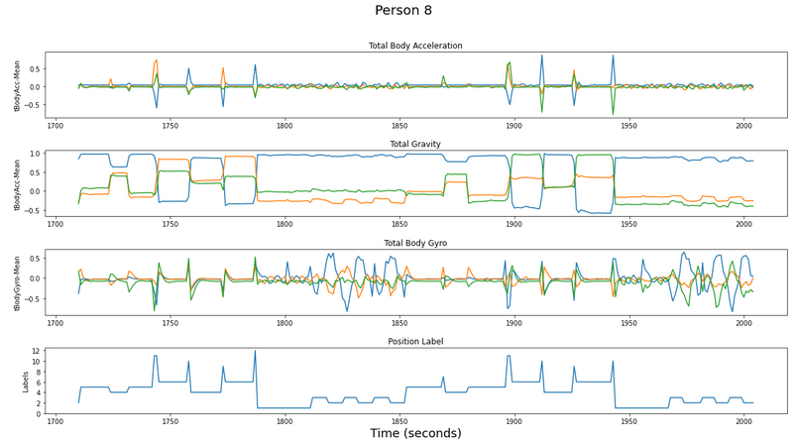
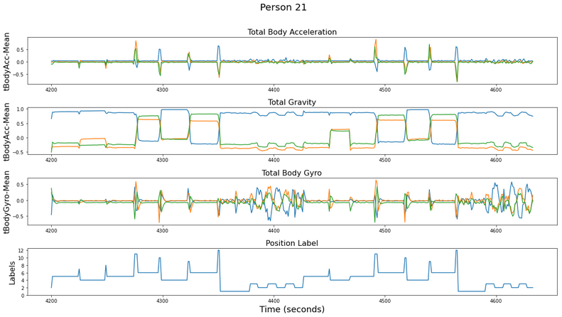
Exploratory Data Analysis visualizing people in motion
Person 8
Person 21

Slide 7
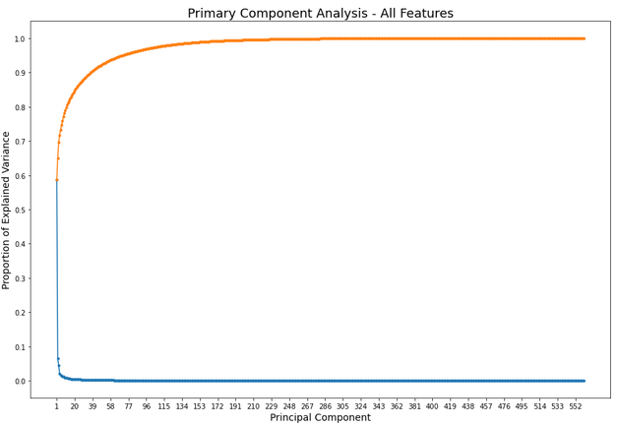
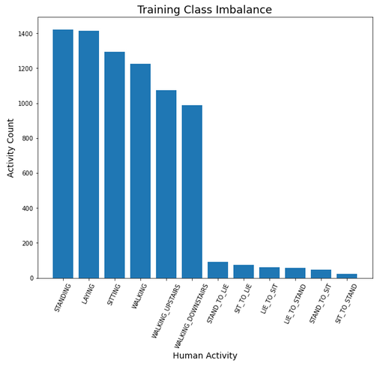
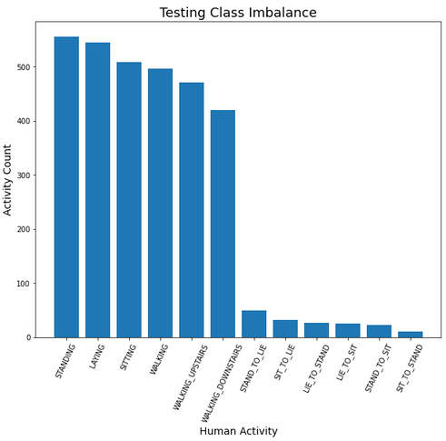
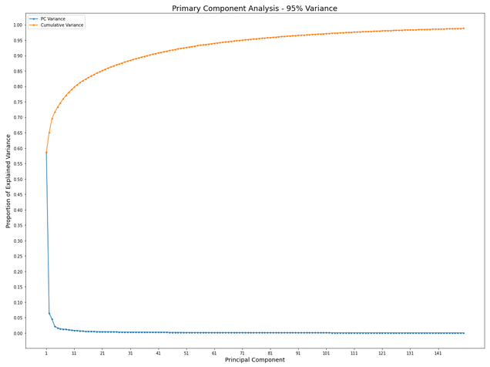
EDA & Feature Selection
Exploratory Data Analysis
Primary Component Analysis
Class Imbalance was similar in the testing and training datasets
75 pcs account for 95% of variance
285 pcs account for 99% of variance

Slide 8
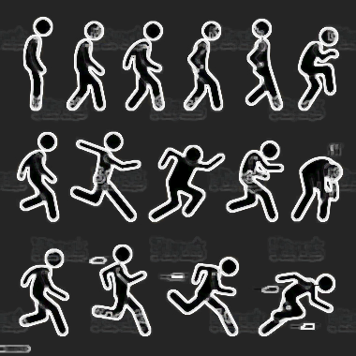
Modeling Techniques
Evaluated Models
Model Tuning
Ensemble Models
Random Forest Classifier
Gradient Boosting Classifier
Xtreme Gradient Boosting Classifier
Non-linear Models
K-Nearest Neighbors Classifier
Model performance measured by classification accuracy
PCA used to reduce features
Models did not perform as well with reduced features
Potential overfitting
Grid Search CV used to tune hyperparameters
Best performance with default parameters

Slide 9
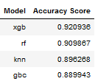
Results & Conclusions
Results
Conclusions & Next Steps
Xtreme Gradient Boosting Machine is best performer at 92% accuracy
Outperformed SVM (89% accuracy) classification on dataset by experiment creators in 2012
Additional data transforms
Rescale, signal outliers, sampling strategy
The models run in this analysis are not suitable for smartphone-based applications
More complex models (CNN, RNN) may perform better (on device, or in cloud)

Slide 10


